Slide 1
Muiltimodal Hate Speech Detection using Fine-Tuned Llama 2 Model
Keerthana Sasidaran Ramaiah Institute of Technology
Geetha J. Ramaiah Institute of Technology

Slide 2
Abstract
Introduction
Literature Survey
Problem Definition
Contents
Proposed Work
Methodology & Implementation
Results & Discussions
Conclusion
References

Slide 3
Abstract
Hate speech detection is crucial for secure online environments, especially with recent policy changes on social media.
This study enhances the Llama 2 model by fine-tuning it with a comprehensive Twitter dataset to improve hate speech detection accuracy.
The system's frontend allows users to upload or record audio, upload videos, or provide YouTube URLs, with processing managed by the Google Speech Recognition API and the Whisper library. The backend integrates advanced speech recognition and video processing technologies.
The refined Llama 2 model achieved an F1 score of 0.96, with accuracy, precision, and recall metrics surpassing other state-of-the-art models.
These results demonstrate the model's high effectiveness and reliability in hate speech detection. This research highlights the potential of transformer- based models in enhancing online safety and inclusivity.
Future work will focus on expanding the dataset, improving model generalization, supporting additional languages, and enhancing system scalability to better handle evolving hate speech forms.

Slide 4
Introduction
Hate speech poses a significant challenge in today's digital landscape, threatening principles of tolerance and inclusivity by targeting individuals or groups based on various attributes.
Robust hate speech detection systems are essential to mitigate the spread of harmful content and address the risks of inciting violence, perpetuating discrimination, and fostering social division.
Large Language Models (LLMs), such as LLama 2, leverage advanced techniques like attention mechanisms and transformer architectures to understand complex linguistic structures.
The proposed research aims to harness the capabilities of the LLama 2 model for hate speech detection by fine-tuning it on a curated dataset to enhance accuracy in identifying hate speech in multimodal content.
The study seeks to demonstrate the effectiveness of this methodology in accurately classifying hate speech content through rigorous experimentation and evaluation, contributing to safer and more inclusive digital spaces.

Slide 5
Literature Survey
A. Advances in LLMs and Model Architectures Modified LLMs, as explored by Pendzel et al. (2023), improve lexical diversity but may impact precision and recall [1]. The 'HateDetector' model combines profanity checks with BERT and MLP, achieving 97.9% accuracy [2]. BiCHAT, using BERT, CNN, and BiLSTM, enhances performance metrics on Twitter [3]. Tailored prompts show promise for zero-shot scenarios but require careful design [4].
B. Data-Driven and Multimodal Approaches Hamzah et al. (2023) achieved 78.5% accuracy with audio features in TikTok videos [5]. Saleh et al. (2023) demonstrated high F1-scores with domain-specific embeddings [6]. Lai et al. (2023) combined audio, text, and video features for 87% accuracy [7].
C. Comparative Analyses and Real-World Applications Studies compared various models including transformers and classical classifiers [8]. ChatGPT achieved a competitive F1-score of 73% on Portuguese tweets [9]. A review from 2010 to 2022 identified trends and future directions [10].
D. Platform-Specific and Ethical Considerations Malik et al. (2022) stressed the need for context-aware models [11]. Saleh et al. (2023) explored LLMs for legally enforceable detection [12]. Studies by William et al. (2022) and García-Díaz et al. (2023) focused on transformer models for Marathi and Telugu [13][14]. Velankar et al. (2022) examined LLM responses in reducing harmful social media content [15].
E. Exploration of Diverse Detection Methods and Models Oliveira et al. (2023) used GloVe embeddings and CNNs for classification [16]. Nasir et al. (2023) and Khanduja et al. (2023) applied various embeddings for hate speech detection [17][18]. Anjum and Katarya (2023) utilized sentence embeddings for Mexican Spanish tweets [19]. Podolak et al. (2023) reviewed pre-trained LLMs and highlighted the need for further refinement [20].

Slide 6
Problem Definition
The proliferation of hate speech on digital platforms presents a formidable challenge, necessitating robust detection mechanisms.
Current approaches, relying on conventional machine learning and single-modal analysis, struggle to effectively identify nuanced hate speech patterns and adapt to evolving online discourse.
Additionally, the absence of methodologies integrating multimodal data exacerbates the limitations of existing systems.
Thus, there is an urgent need for innovative hate speech detection frameworks leveraging advanced computational models such as fine-tuned Llama 2 and multimodal data integration to enhance accuracy and address the complexities of online hate speech.

Slide 7
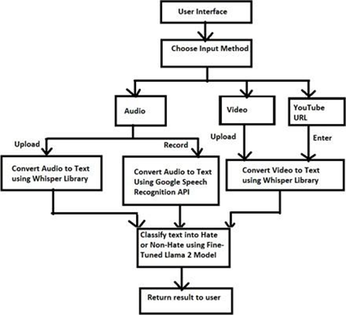
Proposed Work
The proposed work focuses on developing a robust and versatile hate speech detection system using a fine-tuned LLAMA 2 model.
The system will handle multiple input sources, including YouTube URLs, audio, and video, enabling comprehensive coverage of various media formats.
The LLAMA 2 model, a transformer-based architecture, will be fine-tuned to enhance its performance in identifying hate speech, particularly in multimodal contexts.
The system's frontend enables users to either upload or record audio, submit video files, or enter YouTube URLs. Processing is handled by the Google Speech Recognition API and the Whisper library.
On the backend, advanced technologies are integrated for speech recognition and video processing.
Fig. 1 Flow Chart of the Proposed Technique

Slide 8
Methodology & Implementation
Dataset Description & Preprocessing:
The dataset, comprising 24,783 tweets, was categorized into Hate Speech and Non-Hate. Data cleaning involved tokenization, lowercasing, and special character removal. The dataset was balanced to a 60:40 ratio of Non-Hate to Hate tweets, resulting in 10,407 tweets.
Prompt Creation:
A "prompt" column was added to each tweet using feature engineering, making the dataset suitable for LLAMA 2 model training.
Input Handling:
The frontend allows users to upload or record audio, upload videos, or provide URLs.
Data Processing:
Audio and video inputs are converted to text using the Google Speech Recognition API and Whisper library. Text from URLs is similarly processed.
Hate Speech Detection:
The Fine-Tuned LLAMA 2 model classifies the text data for hate speech detection.
Training Process:
The Fine-Tuned LLAMA 2 model for hate speech detection was trained using the NousResearch/Llama-2-7b-chat-hf model on a balanced dataset. Key optimizations included mixed precision (fp16) and progressive early termination (PEFT) for efficiency, along with integer quantization (int4) for faster inference. A learning rate of 2e-4 and a batch size of 10 ensured stable training, with a maximum token length of 512 to handle input complexity. Training was guided by a specified trainer (sft) to align with hate speech detection

Slide 9
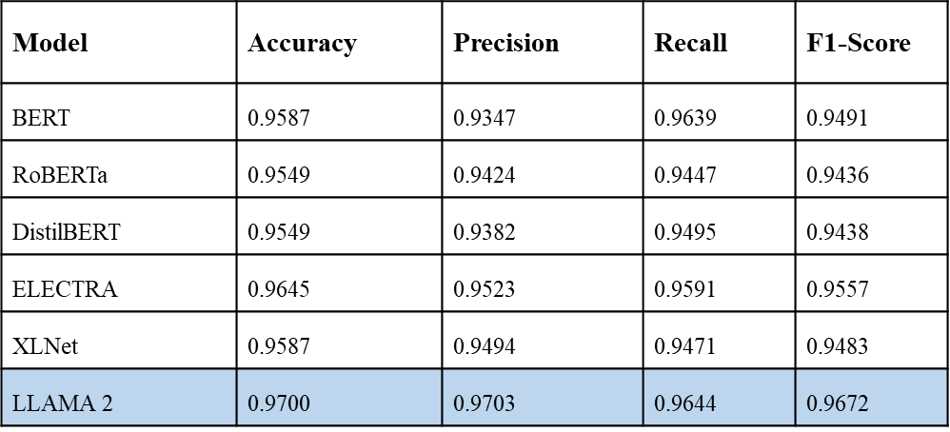
Results & Discussions
LLAMA 2 significantly outperforms existing state- of-the-art models such as BERT, RoBERTa, DistilBERT, ELECTRA, and XLNet, with a notable accuracy of 97%, precision of 97.03%, recall of 96.44%, and F1 score of 96.72%.
These metrics indicate that LLAMA 2 is highly effective in both identifying true instances of hate speech and minimizing false positives.
The model effectively handled diverse input formats, including audio, video, and YouTube URLs, through the use of Google Speech Recognition API and Whisper library.
PERFORMANCE OF THE MODELS

Slide 10
Conclusion
This study demonstrated that the Fine-Tuned LLAMA 2 model excels in detecting hate speech across diverse input formats, including audio recordings, video uploads, and YouTube URLs.
It significantly outperforms existing state- of-the-art models such as BERT, RoBERTa, DistilBERT, ELECTRA, and XLNet, with a notable accuracy of 97%, precision of 97.03%, recall of 96.44%, and F1 score of 96.72%.
These results underscore LLAMA 2’s effectiveness in accurately identifying hate speech and minimizing false positives, thanks to its advanced architecture and fine-tuning process.
The deployment framework, utilizing the Google Speech Recognition API and Whisper library, adds versatility for handling various input types.
Despite these achievements, the study has limitations. The evaluation is conducted in a non-real-time setting, which might not accurately represent the model’s performance in dynamic environments.
Furthermore, the model’s current scope is limited to English, highlighting the need for expansion to support multiple languages and dialects.
Future research should focus on leveraging larger and more diverse datasets, incorporating cultural and linguistic nuances, and applying continuous learning to adapt to evolving hate speech patterns.
Additionally, extending the model’s capabilities to real-time processing and integrating it with a broader range of social media platforms will enhance its practical applicability.

Slide 11
References
[1] Pendzel, S., Wullach, T., Adler, A., & Minkov, E. (2023). Generative AI for Hate Speech Detection: Evaluation and Findings. arXiv preprint arXiv:2311.09993.
[2] Ibanez, Michael & Sapinit, Ranz & Reyes, Lloyd & Hussien, Mohammed & Imperial, Joseph Marvin & Rodriguez, Ramon. (2021). Audio-Based Hate Speech Classification from Online Short-Form Videos. 72-77. 10.1109/IALP54817.2021.9675250.
[3] Anjum, Anjum & Katarya, Rahul. (2023). HateDetector: Multilingual technique for the analysis and detection of online hate speech in social networks. Multimedia Tools and Applications. 1-28. 10.1007/s11042-023-16598-x.
[4] Khan, Shakir & Fazil, Mohd & Sejwal, Vineet & Alshara, Mohammed & Alotaibi, Reemiah & Kamal, Ashraf & Baig, Abdulrauf. (2022). BiCHAT: BiLSTM with deep CNN and hierarchical attention for hate speech detection. Journal of King Saud University - Computer and Information Sciences. 34. 10.1016/j.jksuci.2022.05.006.
[5] Hamzah, Salehah & Mohd, Masnizah & Zakaria, Lailatul. (2023). Detection of Online Hate Comments Based on Feature Embedding and Deep Learning. 239-244. 10.1109/AiDAS60501.2023.10284606.
[6] Salminen, Joni & Hopf, Maximilian & Chowdhury, Shammur & Jung, Soon-Gyo & Almerekhi, Hind & Jansen, Jim. (2020). Developing an online hate classifier for multiple social media platforms. 10. 1. 10.1186/s13673-019-0205-6.
[7] Lai, Mirko & Celli, Fabio & Ramponi, Alan & Tonelli, Sara & Bosco, Cristina & Patti, Viviana. (2023). HaSpeeDe3 at EVALITA 2023: Overview of the Political and Religious Hate Speech Detection task.
[8] Sarthak Roy, Ashish Harshvardhan, Animesh Mukherjee, and Punyajoy Saha. 2023. Probing LLMs for hate speech detection: strengths and vulnerabilities. In Findings of the Association for Computational Linguistics: EMNLP 2023, pages 6116–6128, Singapore. Association for Computational Linguistics.
[9] Boishakhi, F. T., Shill, P. C., & Alam, M. G. R. (2021, December). Multi-modal hate speech detection using machine learning. In 2021 IEEE International Conference on Big Data (Big Data) (pp. 4496-4499). IEEE.
[10] Luo, C. F., Bhambhoria, R., Zhu, X., & Dahan, S. (2023). Towards Legally Enforceable Hate Speech Detection for Public Forums. arXiv preprint arXiv:2305.13677.

Slide 12
References
[11] Malik, J. S., Pang, G., & Hengel, A. V. D. (2022). Deep learning for hate speech detection: a comparative study. arXiv preprint arXiv:2202.09517.
[12] Saleh, H., Alhothali, A., & Moria, K. (2023). Detection of hate speech using BERT and hate speech word embedding with deep model. Applied Artificial Intelligence, 37(1), 2166719.
[13] William, P. & Gade, Ritik & Chaudhari, Rup & Pawar, A. & Jawale, M.. (2022). Machine Learning based Automatic Hate Speech Recognition System. 315-318. 10.1109/ICSCDS53736.2022.9760959.
[14] García-Díaz, J. A., Jiménez-Zafra, S. M., & Valencia-García, R. (2023). UMUTeam at HOMO-MEX 2023: Fine-tuning Large Language Models integration for solving hate-speech detection in Mexican Spanish.
[15] Velankar, A., Patil, H., Gore, A., Salunke, S., & Joshi, R. (2022). L3cube-mahahate: A tweet-based marathi hate speech detection dataset and bert models. arXiv preprint arXiv:2203.13778.
[16] Oliveira, A. S., Cecote, T. C., Silva, P. H., Gertrudes, J. C., Freitas, V. L., & Luz, E. J. (2023, September). How Good Is ChatGPT For Detecting Hate Speech In Portuguese?. In Anais do XIV Simpósio Brasileiro de Tecnologia da Informação e da Linguagem Humana (pp. 94-103). SBC.
[17] Nasir, A., Sharma, A., & Jaidka, K. (2023). LLMs and Finetuning: Benchmarking cross-domain performance for hate speech detection. arXiv preprint arXiv:2310.18964.
[18] Khanduja, N., Kumar, N., & Chauhan, A. Unmasking Hate: Telugu Language Hate Speech Detection Using Transformers. Available at SSRN 4642780.
[19] Anjum, & Katarya, R. (2023). Hate speech, toxicity detection in online social media: a recent survey of state of the art and opportunities. International Journal of Information Security, 1-32.
[20] Podolak, J., Łukasik, S., Balawender, P., Ossowski, J., Bąkowicz, K., & Sankowski, P. (2023). Analyzing the Influence of Language Model-Generated Responses in Mitigating Hate Speech on Social Media Directed at Ukrainian Refugees in Poland. arXiv preprint arXiv:2311.16905.
[21] Davidson T, Warmsley D, Macy M, Weber I (2017) Automated Hate Speech Detection and the Problem of Offensive Language. Proceedings of the International AAAI Conference on Web and Social Media. https://doi.org/10.1609/icwsm.v11i1.14955

